Slide 1
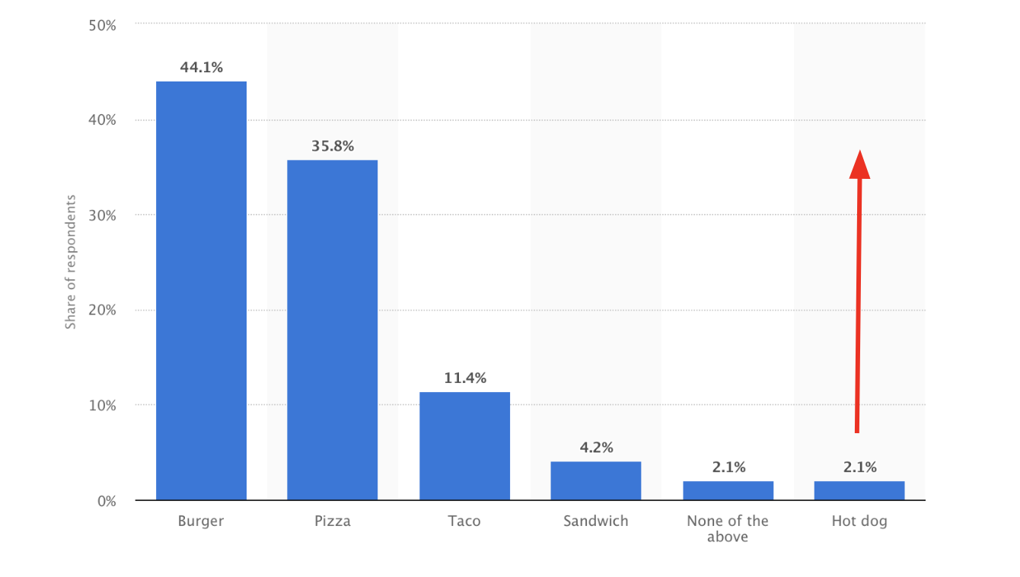
The challenge as originally issued by Wienerschnitzel was to “change consumer perception about a product everyone is familiar with--the hot dog. […] with Wienerschnitzel leading the charge.” The research laid out on the following pages keeps in mind at all times that this is not just another marketing campaign for Wienerschnitzel, but a national effort to elevate the perception of the hot dog.
However, while previous campaigns with similar goals (such as those championing eggs and avocados) focused on trying to change public misconceptions about their respective health benefits, our research led us to a different understanding on what it means to “elevate” perception. We believe that elevating the perception of the hot dog does not mean trying to convert people who will never think the hot dog is a healthy option, but getting consumers who already eat hot dogs to consider it over their usual fast food go-to as an everyday opportunity, not just at ballgames and cookouts.
The overall goal of our campaign is to elevate hot dogs into primary consideration sets among fast foods, so that they are top of mind and actively sought out rather than passively accepted in specific situations. Successfully reaching this most readily approachable target will then give the hot dog industry and Wienerschnitzel in particular a realistic base from which to expand among the rest of the nation. Once our target actively recalls the hot dog as a viable and delicious quick food option, they are likely to transition into hot dog advocates and will be a vital first step in elevating hot dog perceptions among all psychographics.
We will explore our exact target market in greater depth later, but they closely follow the psychographics of the Trendmaker target outlined in the case study. Especially pertinent is the fact that they “reward themselves for working hard, and follow cravings.” As we will see later, our definition of the Connectors do indeed aspire to the Trendmaker habit of “look[ing] out for what’s new and interesting.”
1
Notes:
*big questions*
How many pages does Account Planning have?
Do we need to write the exact copy or will it be translated?
SWOT Alternatives

Slide 2
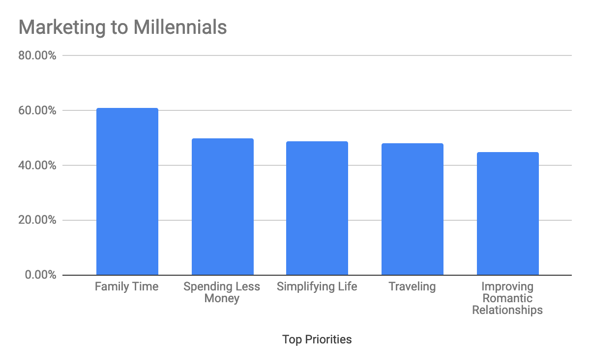
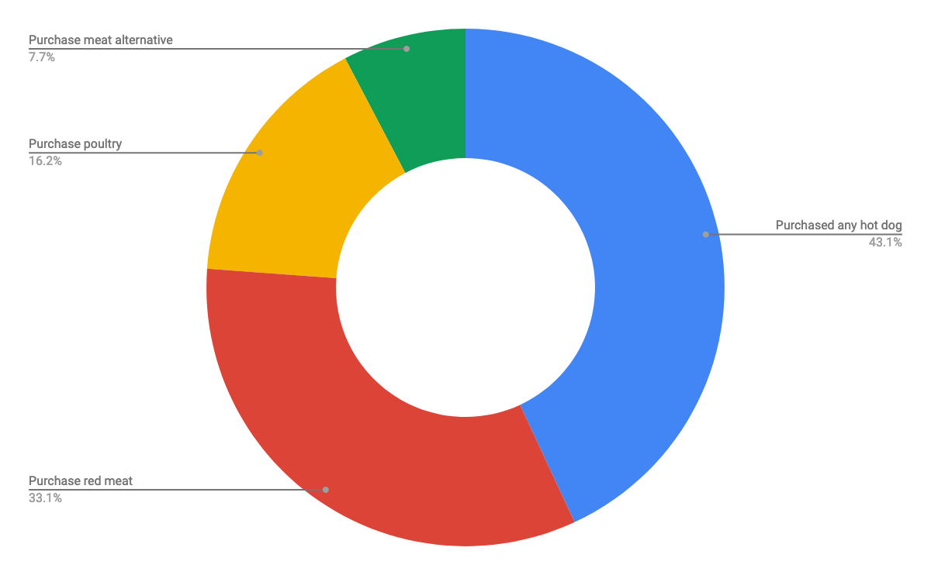
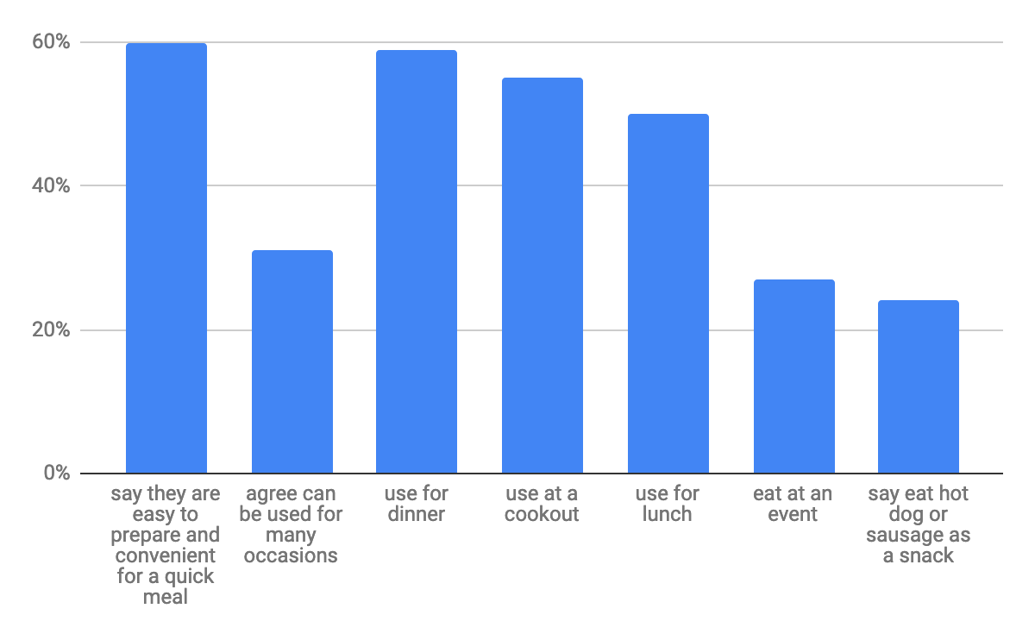
Secondary
As we conducted secondary research, we started to see patterns emerging that helped us identify our target and craft our Big Idea.
The Restaurant Decision-Making Process
Men²
Spend more than women dining out in both LSR and FSR
More apt to visit each of the restaurant types
Tie into sports teams, events, or athletes
Marketing to Millennails ***
Top priorities³
Hot Dog and Sausages
Opportunities
Consumer participation is still high at 73%
50% buy more than one type of hot dog/sausage→ like diversity
When do you eat hot dog/sausage?⁴
Ease and adaptability leads to use across the day and over a variety of occasions
Diverse occasions, ease, and convenience
The Consumer-
73% of consumers purchase hot dogs or sausages
Men are slightly more likely to buy hot dogs and sausages and are more likely to consumer across packaged red mead
Millennials are core hot dog and sausage buyers
Value, convenience and versatility
Purchase drivers for men 25-34
58% purchase because like the taste
56% purchase because easy to prep
We are narrowing down the target they gave us
80% of 28-34 eat fast food
72% Eat Hot Dogs
Likely to Brand Switch
Open to adventure and trying new things
RESEARCH INSIGHT=everyone knows hot dogs, but people forget them
Notes:
As we conducted secondary research, we started to see patterns emerging that helped us identify our target and craft our Big Idea.
We realized that Men spend more than women in dining out(2) and that they are more likely to purchase hot dogs and sausages. (4) Between the ages of 25 to 34, 79% are core hot dog and sausage buyers.
When marketing to millennials, their top priorities include family time, spending less money, simplifying life and traveling. According to Mintel, men want to reach beyond their boundaries, learn new skills, meet new people and advance at work.(3)
(Maria) Secondary research, our target → saw patterns emerging
Documentary / History
(We had questions about perceptions, locations, context, who is eating them)
Hot dogs
The Restaurant Decision-Making Process http://academic.mintel.com.ezproxy.lib.utexas.edu/display/742270/?highlight#hit1
Men
Spend more than women dining out in both LSR and FSR
More apt to visit each of the restaurant types
Biggest spenders are men 35-54
Tie into sports teams, events, or athletes
Marketing to Millennails http://academic.mintel.com.ezproxy.lib.utexas.edu/display/901718/?highlight
Top priorities
61% family time
50% spending less money
49% simplifying life
48% traveling
45% improving romantic relationships
Millennials over index on interest in getting promoted but don’t consider a priority
Settling down→ nesting phase, home and family is focus while career is on autopilot
Men-reach beyond their boundaries, they want to learn new skills, meet new people, and advance at work
Hot Dog and Sausages http://academic.mintel.com.ezproxy.lib.utexas.edu/display/794129/
Opportunities
Consumer participation is still high at 73%
50% buy more than one type of hot dog/sausage→ like diversity
Purchased any hot dog-56%
43% purchase red meat
21% purchase poultry
10% purchase meat alternative
When do you eat hot dog/sausage?
Ease and adaptability leads to use across the day and over a variety of occasions
Diverse occasions, ease, and convenience
60% say they are easy to prepare and convenient for a quick meal
31% agree can be used for many occasions
59% use for dinner
55% use at a cookout
50% use for lunch
27% eat at an event
24% say eat hot dog or sausage as a snack
The Consumer-
73% of consumers purchase hot dogs or sausages
Men are slightly more likely to buy hot dogs and sausages
Men are more likely to consume across packaged red meat
More likely to purchase than a female
Women are less likely to eat or use hot dogs and sausages across a variety of occasions, with the exception of at a cookout and as an ingredient in an entree
Younger adults and parents to be are also more engaged
Eat all day long
Use as an ingredient for an entree
Millennials are core hot dog and sausage buyers
Value, convenience and versatility
Possibly because nostalgia and familiarity with hot dogs
25-34-79% purchase any hot dog or sausage
Drops after
35-44 drops to 75%
45-54% drops to 67%
Increases at 55-64-up to 72%
Purchase drivers
Like the taste-60%
Easy to prepare-60%
Kids like them-52%
Affordable-26%
Used for many occasions-31%
Good for social gatherings-30%
Good source of protein-25%
Crave them-24%
25-34
58% purchase because like the taste
56% purchase because easy to prep
We are narrowing down the target they gave us
Men; 28-34
Fast-Food Frequents
2x a Week
Already eat hot dogs
Nostalgic
Want something quick, easy, and not messy
“On the go”
They exercise regularly
80% of 28-34 eat fast food
72% Eat Hot Dogs
Likely to Brand Switch
Open to adventure and try new things
Wienerschnitzel
Pattern=everyone knows hot dogs, but people forget them
Target=eat fast food and like hot dogs
People are active who eat fast food
Men 28-34 particularly eat fast food a lot

Slide 3
Primary Research
21,126,000 males in the US aged 25-35
52% are single
18.5% earn 100k-150k
8% earn 75K-99K
39% more likely than the average to earn 25-29K
6
Primary research
20 in-depth Interviews aged 28-34
# respondents on a survey: 378
We dove deeper into our secondary research and interviewed 20 people to get more in depth answers and make our target: Here are the patterns/ consumer insight we got:
Interests: They spend money on experiences, playing sports, reading, traveling
They are very active! “I lift weights 5x a week” “I love to go hiking and camping on the weekends” “I like to play sports with my friends” “I like to travel to new places with my disposable income”
They value and are motivated by: Family time, traveling, and moving up in career
Prefer to “feel like they are eating healthy”.
THOUGHTS ON MEAT:
Eat fast food 2x a week
Eat meat 1x a day
Majority did not care about what was in their meat
“I don’t think about it, I’ve heard it’s bad but I’ve never looked into it”
“As long as it tastes good I could care less”
They Love Hot Dogs
“I like hot dogs, but would not go out of my way for one.”
“It tastes like a hot dog?”
I LOVE hot hogs
I don’t feel guilty because I work out and have a healthy lifestyle
They remind me of…being in my baseball uniform and eating them after a game with my friends
Cultural Insight:
As a culture we have “heard” that processed meat is bad but that does not stop most people from eating it. If they are presented with the option to eat a hot dog, they will take it.
We found that people don’t feel guilty about eating hot dogs
Future Insight
The first step is to connect people who already crave hot dogs and don’t feel bad about processed meat
They most likely target to get on board are trend setters, they follow their cravings and bring people with them

Slide 4
Our Target:
Millenial men ages 28-34
Across income levels
Living everywhere in the US, centered in urban environments³
Personality:
Social - Happy Hours with friends and spending time with family
Sports fan
Staying connected:
Digitally (Apple News/BBC/online articles/podcasts)
Hulu/Netflix/Instagram heavy/Facebook
Values:
Work hard play hard
Experiences like traveling and sports
Convenience
Attitudes:
Willing to take risks and work long hours to get to the top of their profession.
Interests:
Working out / being active
Playing sports
Owns a Mac computer and use it for reading/writing blogs, and watching TV programs and movies.
Lifestyle:
Trendy
Enjoys doing things with other people
Likes “feeling” healthy
How do they use product:
As they go about their busy days
Persona:
Our target market is filled with high-energy, highly motivated guys that stay socially and physically active. These are busy people that prioritize their time, but they play as hard as they work. Some of them work in open-plan and shared office spaces. When it comes to what they eat on the go, which they do frequently, they want quick and good-- they’ve earned it. They highly value their family and friends.
Across income levels, they value convenience and quality over cost sensitivity. This target fits into the Trendmaker persona in the sense that they are social individuals that often bring others along with them. Many of them are aware and lend some value to current lifestyle trends, but prioritize their own individual tastes and priorities above all else.
Front Runner
Software engineer for a startup (Add picture and quote)
Financial analyst
“Add picture and quote”

Slide 5
Big Idea
The Craving You Forgot
When asked about hotdogs, the target immediately says “I love them!”
However, they also don’t go out of their way to buy them
We are reminding people of their favorite food from their childhood,
We want to make it top of mind for them so that they’re actively seeking them out as opposed to passive consumption. This target is the most likely to make the switch into active consumption, making them the vital first step to widespread elevation.
Deep in the depths of our memories lurks an appetite we thought we had left in our childhood. But when a hungry soul goes out of their way to order a hot dog off the menu, that yearning returns and a surge of jealousy comes with it. We’ve always believed our love for hot dogs was a product of adolescence, but could it be that our naivety kept us from enjoying them into adulthood?
It’s time we permanently remember that craving we used to long for so much.

Slide 6
Works Cited
“Favorite fast foods among consumers in the U.S. 2017.” Statista, August 2017, https://www.statista.com/statistics/235595/favorite-foods-in-us/
Gallo-Torres, Julia. “The Restaurant Decision-making Process - US - July 2015.” Mintel, July 2015, academic.mintel.com.ezproxy.lib.utexas.edu/display/716570/
Macke, Dana. “Marketing to Millennials - US - June 2018.” Mintel, June 2018, academic.mintel.com.ezproxy.lib.utexas.edu/display/860529/?highlight
Averbook, Michael. “Hot Dogs and Sausages - US - October 2017.” Mintel, Oct. 2017, academic.mintel.com.ezproxy.lib.utexas.edu/display/794129/
Spencer, Hannah. “Foodservice Online Ordering and Delivery - US - November 2018.” Mintel, Nov. 2018, academic.mintel.com.ezproxy.lib.utexas.edu/display/860851/?highlight
Simmons. www.simmonsresearch.com

