Slide 1
Secondary Research and Insights

Slide 2
The Ask
By elevating the perception of the hot dog, consumers who already eat fast food and like hot dogs will consider eating hot dogs over their usual go-to.
Notes:
COLTON !!!

Slide 3
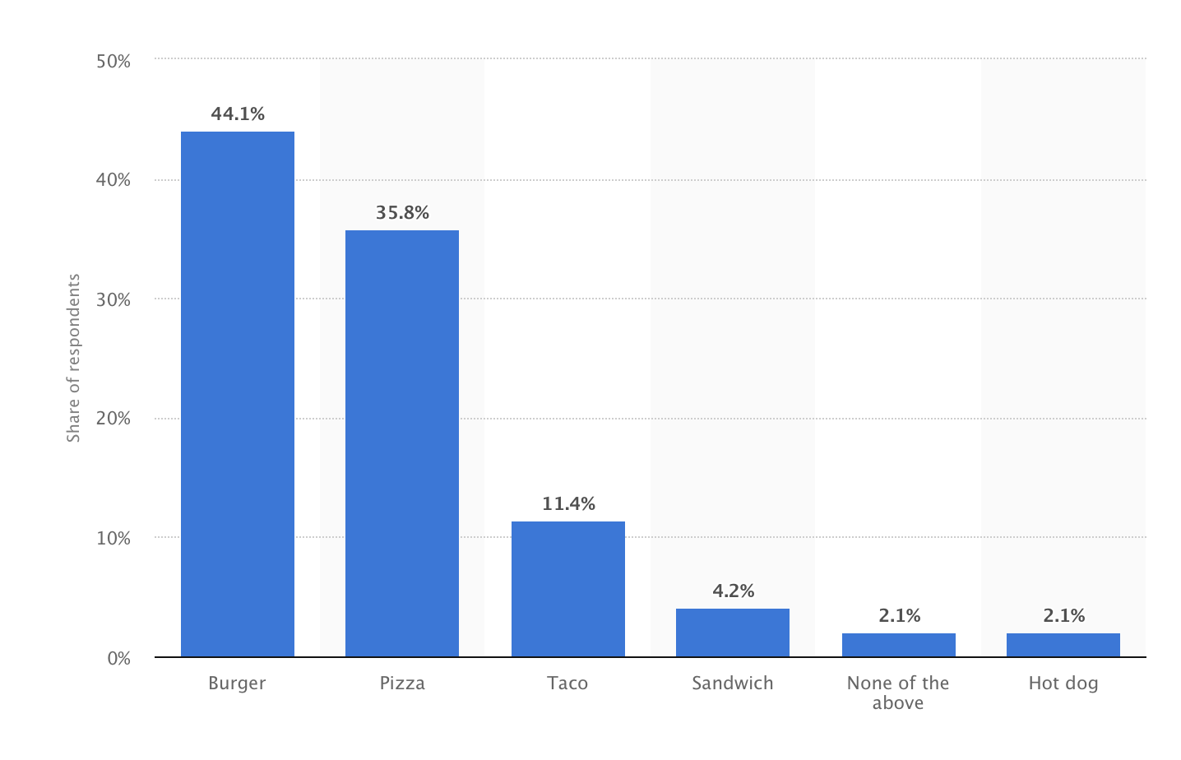
The Ask
Notes:
COLTON!!
Favorite fast food among consumer https://www.statista.com/statistics/235595/favorite-foods-in-us/

Slide 4
Problem Areas
Goal: Change the negative perceptions of the hot dog to increase consumption
Problem: People avoid hot dogs or don’t think about hot dogs as an option when making decisions to dine out
So What:
Not trying to convince people that hot dogs are good for you
Focus on people who are already eating hot dogs and fast food
Notes:
LAURA
There are a number of misconceptions surrounding the hotdog (as presented in the case study) like what they are made of, their level of unhealthiness, and that they are a basic food that cause people to avoid them but another big problem for Wienerschnitzel is that people are not thinking about them when making choices to eat out.
We don’t think we should try to elevate the status of the hot dog with good-for-you claims.
We think it will be most effective to try to turn hot dogs into a meal preference for people who already like/consumer hot dogs and fast food rather than trying to convince / convert people who don’t and likely have strong negative feelings towards them.

Slide 5
Hot Dogs: An American Mythology
Disputed History
Multicultural Origin
Classless Food
Condiments are key
Pioneering Fast Food
Notes:
Colton

Slide 6
Hot Dogs Research
Myth:
All kinds of meat and meat by-products
Bizarre sludge
Truth:
Meet cut away from steaks and roasts finely ground and mixed with other spices
U.S. Department of Agriculture requires disclosure on the ingredient label
as "with variety meats" or "with meat by-products
Notes:
BRI
Most commonly pieces of meat cut away from steaks or roasts. It is then very finely ground and mixed with other spices. Variety meats or organ meats are not typically used in hot dogs or sausages and if organs are used, the specific organ will be included in the ingredients statement on the package and the front of the package will declare “with variety meats” or “with meat byproducts.”

Slide 7
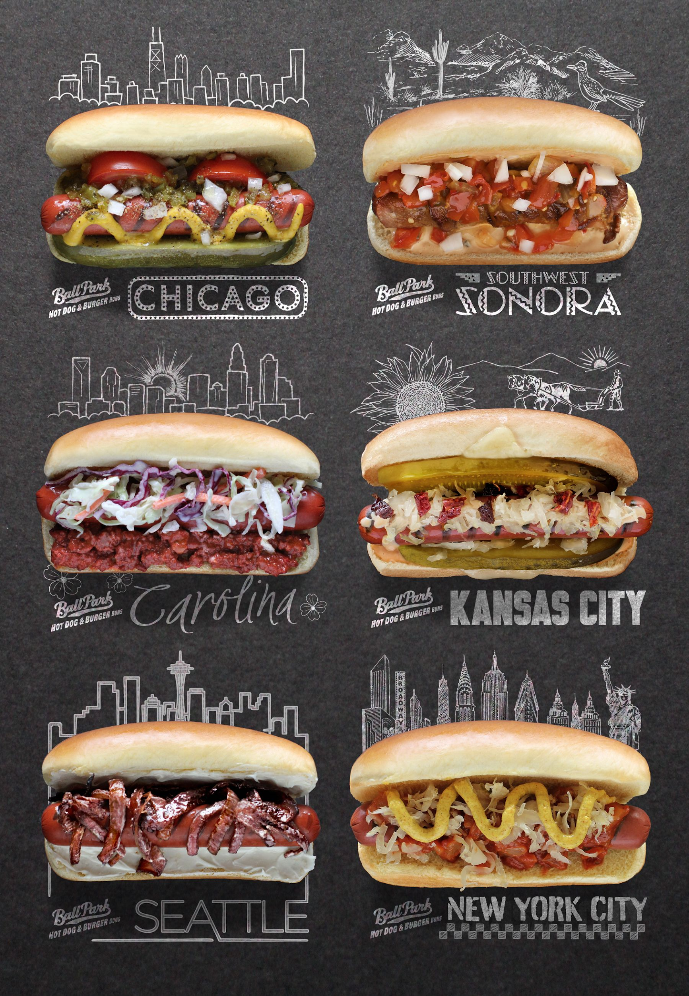
Hot Dog Research
Why do people not buy hot dogs?
65.40% bought fast food (burgers or hot dogs) in the last 30 days
Baseball games etc; for all ethnicities/incomes. “They quickly became a democratic food”
Americans are 6 times more likely to prefer a hot dog made with a short list of ingredients
Hot dogs and social gatherings: 50%+ of buyers eat them at a cookout, 44% more likely to eat them during summer
High association between fast food and snacking
Too processed 36%
Unhealthy 28%
Too much sodium 27%
Too much fat 23%
79.69% of consumers aged 25-34 eat hot dogs
59.27% (191.62 million) eat all beef hot dogs--way more than mixed meats or alternatives
Notes:
Rebekah
9%, cheap equalizer.
Simple too.
Cover in swot.
Among younger.
Middle graphic is reference to the wide regional variety and competition; however, WS offers combos more than customization. Although we may want to focus any toppings shown in creative according to the regions we’ll point out later in geography.

Slide 8
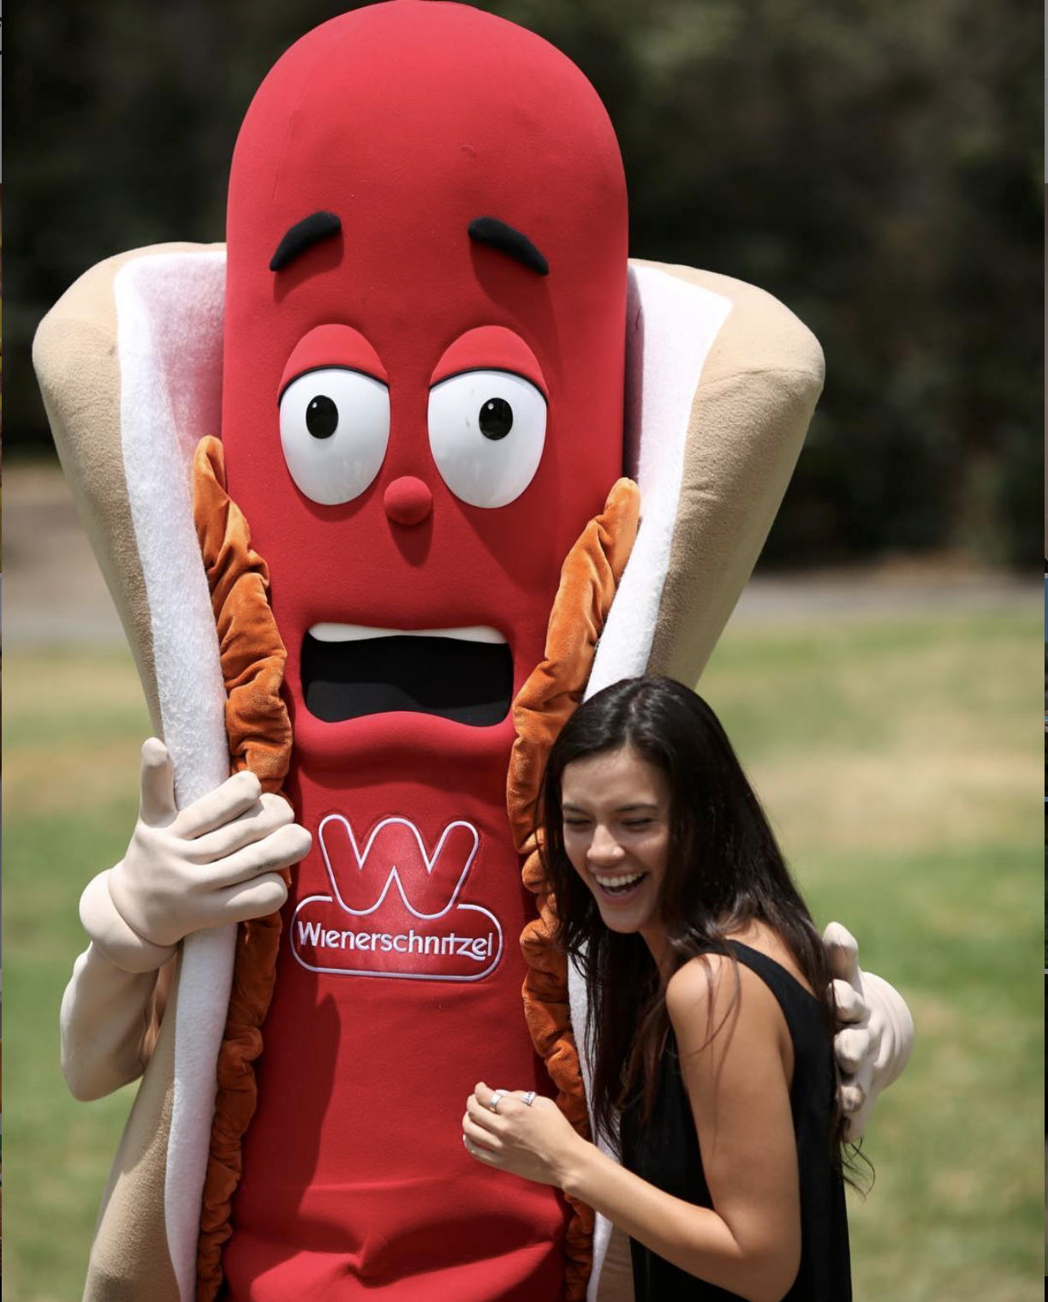
Wienerschnitzel
What we know:
Average 43 years old
Brand Presence:
Playful, Welcoming, X Games Community
Haven’t found a cohesive voice
Notes:
BRI
Talk about Our Experience - friendly customer service, mix of people, women asked about coupons - it was kinda a snack we didn’t feel gross after

Slide 9
S
Cheap
Portable
Convenient
Quality food that tastes good
Good customer service
O
87% of consumers say QSRs are the most convenient option
Millennials have not completely cut out the meals they had as children; nostalgia can be used
W
T
Majority of consumers are burger lovers (64%)
Rise of experience-based dining,
plant-based meal options
Abundance of other foods; ethnic options
Negative perception as an unhealthy, occasional treat
Summer food
Notes:
JACLYN
Plant-based “Meatless Mondays”-22% of Millennials are cutting back on animal protein

Slide 10
Competitors
Fast Food
Wendy’s: viral social media/social engagement, brand voice, sleek design
Taco Bell: innovative products, clever marketing, “higher quality” Cantina concept
Grocery Store
Ball Park - “Plump when you cook ‘em”
Oscar Mayer - “Better hot dog for all”
Hebrew National - “The better than a hot dog hot dog” & “We answer to a higher authority”
Nathan’s Famous
Notes:
http://academic.mintel.com/display/896212/
Fast Food: Shannon
Grocery Store: Krista

Slide 11
Successful Re-Brands
Foods:
Avocados
Eggs
Milk
Problem:
People didn’t understand the difference between healthy and unhealthy fats.
A viral video saying the way eggs were hatched was inhumane.
People were drinking less milk, and more soft drinks.
Turning Point:
Super Bowl cemented guacamole as a snack item.
“The good egg” campaign showing transparency.
Remind Milk Drinkers of the anxiety that came when milk wasn’t available at crucial moments.
Notes:
SHANNON + BRI
http://academic.mintel.com/display/896212/
https://are.berkeley.edu/~sberto/2009Got_Milk.pdf

Slide 12
Target Information
We are narrowing down the target they gave us
Men; 28-34
Fast-Food Frequents
2x a Week
Already eat hot dogs
Nostalgic
Want something quick, easy, and not messy
“On the go”
They exercise regularly
80% of 28-34 eat fast food
72% Eat Hot Dogs
Likely to Brand Switch
Open to adventure and try new things
Notes:
Colton
Men-reach beyond their boundaries, they want to learn new skills, meet new people, and advance at work

Slide 13
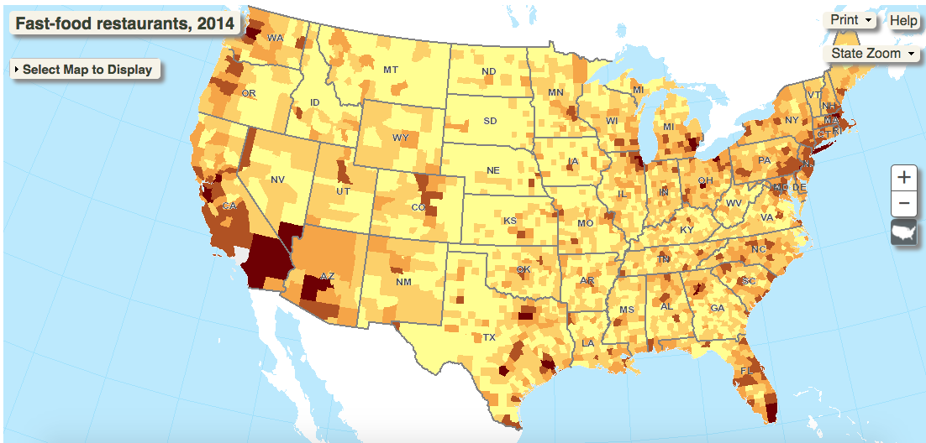
Geography
Southern California, southern Arizona, big metropolitan areas in Texas, areas near lake Michigan, southern Florida, and the New York (West Coast) area have a higher density of fast-food restaurants
https://www.ers.usda.gov/data-products/food-environment-atlas/go-to-the-atlas/
Notes:
Maria

Slide 14
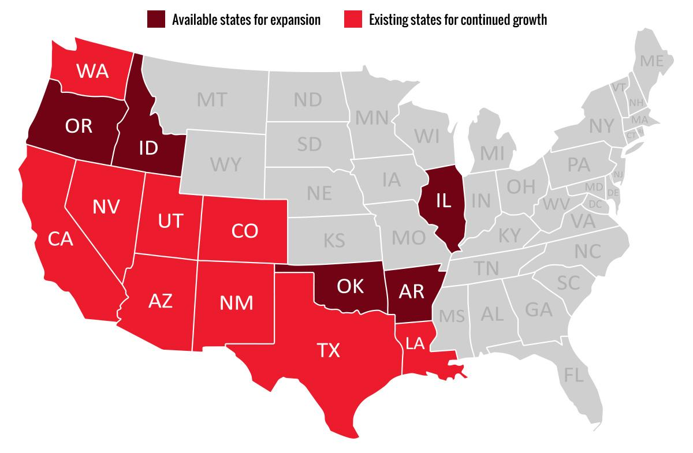
Geography
https://www.ers.usda.gov/data-products/food-environment-atlas/go-to-the-atlas/
Notes:
Maria

Slide 15
Geography
Notes:
Maria

Slide 16
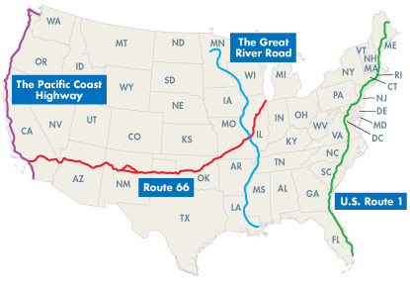
Geography
Two of the top road trip routes have dense Wienerschnitzel stores, could promote the convenience and “fun” values associated with the hot dog.
According to Mintel 48% of millennials prioritize traveling and 50% prioritize less spending.
Notes:
Maria

Slide 17
Main Insights | Data Patterns
Snacking
Convenience is key
Target not as focused on “healthy eating options”
Familiarity is priority
Nostalgia / Social Gathering Food
Indulgence / Guilty Pleasure
Consume more packaged red meat
More likely to eat hot dogs year round
Eat as a snack (24%)
Notes:
KRISTA
-Quarter of hot dog and sausage buyers indicate they eat them as a snack

Slide 18
Next Steps
Target Market/Persona
Questions for Primary Research
Hot Dog Branding as “American,” vs ethnic roots/fusion
Gourmet perception vs fast food only
Negative perceptions of hot dogs
Lying about eating hot dogs, emotions like shame
Hot Dog personified/WS personified
First hot dog story
Where do you see yourself when you eat a hot dog?
Big Idea
Notes:
KRISTA

