Slide 1
Primary Research

Slide 2
Follow Up Research
52% are single
43% are married
41% have kids
18.5% earn 100k-150k
8% earn 75K-99K
39% more likely than the average to earn 25-29K
21,126,000
males in the US aged 25-35
They are mostly single, their income varies, and they live everywhere.
Notes:
Brianna

Slide 3
Interviews
Goal: Gain deeper insight into the behaviors and psychographics of our target and understand their perceptions of hot dogs and fast food.
8
30 min. interviews
Men ages 28-34
Live in TX and CA
Entrepreneurs, Executives, Freelancers, and Mid-level Managers
Notes:
Brianna
8 interviews, average 30 minutes
All male, 28-34
Living in Texas and California
Jobs ranged from Entrepreneurs, Executives, Freelancers, and Mid level managers
Goal for interviews
Insight into behavior and psychographics of our target market
Understand their perception about Hot Dogs

Slide 4
Hobbies
Priorities
Experiences like happy hours, playing sports with friends
Reading
Traveling
Family time, traveling, and moving up in career = high
Settling down and simplifying life = lowest
Spending less money = Varies-low vs high
Notes:
Krista
Experiences like traveling, happy hours, playing sports with friends
Reading
Traveling both within America and abroad

Slide 5
Food Consumption
Prefer to “feel like they are eating healthy”
Friends introduce them to new places to eat and they are open to treating themselves, but that is not a high priority
2x a week
East fast food on average
1x a day
Eat Meat
They like to make their own food but also eat out quite a bit
Notes:
Laura
Favorite fast food restaurants include Taco Bell, In-N-Out, Chick fil A. Prefer to “feel like they are eating healthy”
Friends introduce them to new places to eat and they are open to treating themselves but that is not a high priority
On average, they eat fast food 2 times a week
Eat meat at least one time a day
Like to make their own food, but eat out quite a bit

Slide 6
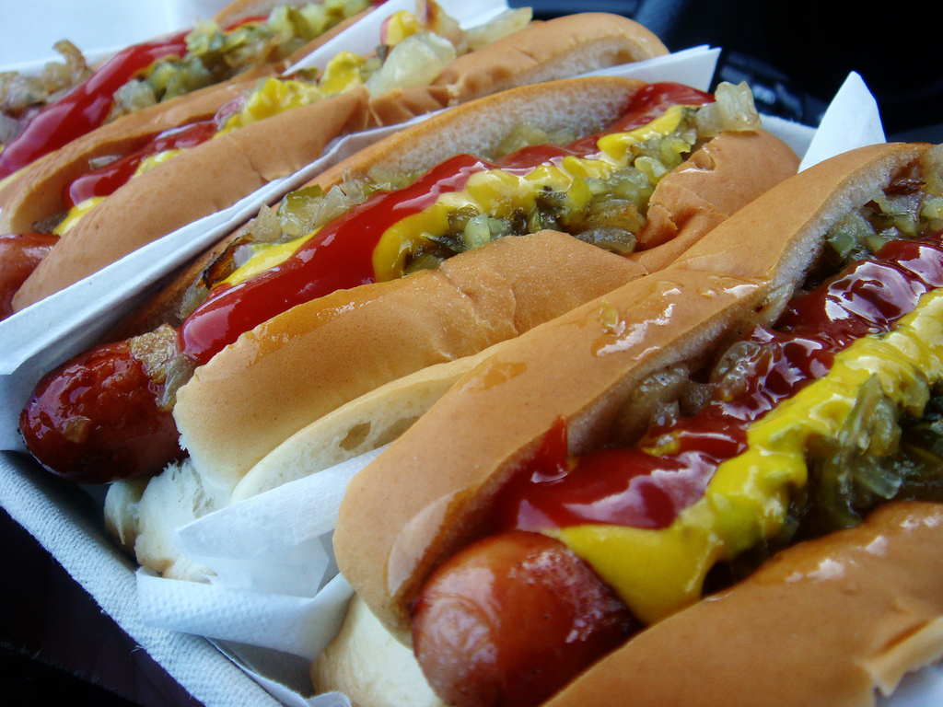
Meat/Hot Dog Perceptions
Majority did not care about what was in their meat
“I know it’s bad but it tastes good. It doesn’t bug me much.”
“I don’t think about it.”
Hot Dogs
“I like hot dogs but would not go out of my way for one.”
“It tastes like a hot dog?”
Eat Hot Dogs at:
Sporting events
Grill out
Home
Notes:
Rebekah

Slide 7
“Eaten there once and it’s kind of gross. Just wasn’t very good. Have not been in a very long time.”

Slide 8
“There’s one by Domain. I wouldn’t seek it out, but if i really wanted a hot dog that’s where I would go, because that’s their specialty.”

Slide 9
“Reminds me of the family business, it was right down the road, When I needed to feed myself I would grab a hot dog and keep going.”

Slide 10
“Went in highschool and got food poisoning”

Slide 11
“First thing that comes to mind was that it is random. I lived by one in college and thought it was random.”

Slide 12
“Wouldn’t go out of the way to get it, but nice to mix up other places like hamburger joints.”

Slide 13
“The Chili dogs are good, but probably unhealthy. In California they have mixed reviews, some people say they are gross, some think they are good. I lived down the street and it was convenient.”

Slide 14
Media Consumption
Notes:
Maria
Instagram
Youtube
Netflix
Hulu
Spotify
Radio Talk Show News
LinkedIn
Snapchat
Twitter
Podcasts
Facebook

Slide 15
Common Occupations for Target
Finance
Financial Analysts
Statisticians
Marketing
Telemarketers
Meeting and event planners
Advertising and promotions managers
Market research analysts and marketing specialists
Technology
Web developers
Hospitality
Bartenders
Waiters
Medical
Emergency medical technicians and paramedics
Physician assistants
Notes:
Shannon

Slide 16
Target Persona
Our target market is filled with high-energy, highly motivated guys that stay socially and physically active. These are busy people that prioritize their time, but they play as hard as they work. Some of them work in open-plan and shared office spaces, and when it comes to what they eat on the go, which they do frequently, they want quick and good-- they’ve earned it. They highly value their family and friends.
Across income levels, they value convenience and quality over cost sensitivity. This target fits into the Trendsetter persona in the sense that they are social individuals that often bring others along with them. Many of them are aware and lend some value to current lifestyle trends, but prioritize their own individual tastes and priorities above all else.
Notes:
Create a persona for our target
Colton

Slide 17
Target
1. Unbuttoned Achiever
2. Active Pathfinder
3. Relaxed / Casual Front Runner
4. Bustling Doer
5. Laid-Back Hustler
Notes:
Create a persona for our target
active, casual, not strict, lenient, motivated, balanced, well rounded, relaxed bustling, unbuttoned, laid back, transitioning, up-and-comer

Slide 18
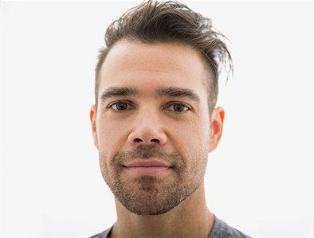
What should we name him?
Notes:
Create a persona for our target

Slide 19
Questions
What else do you need us to research?

Slide 20
Help us get the survey out to our target!

